Slide 1
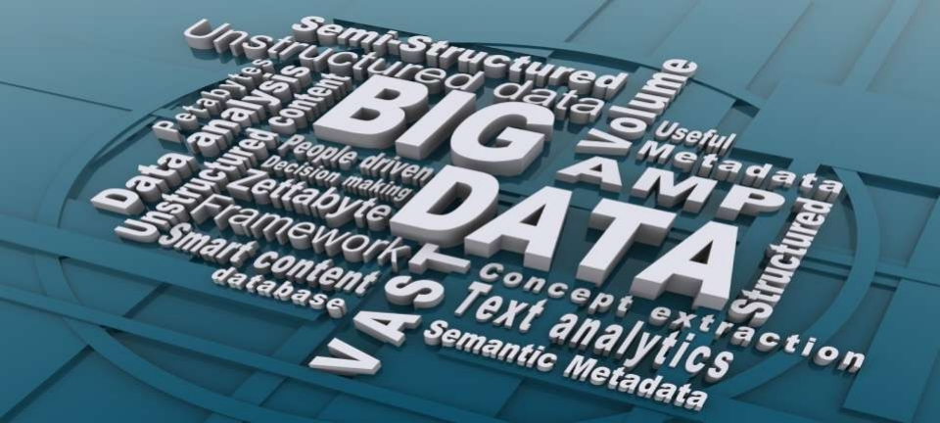
BIG DATA
Prepared By
Nasrin Irshad Hussain And Pranjal Saikia
M.Sc(IT) 2 nd Sem
Kaziranga University Assam

Slide 2
Content
1. Introduction
2. What is Big Data
3. Characteristic of Big Data
4. Storing,selecting and processing of Big Data
5. Why Big Data
6. How it is Different
7. Big Data sources
8. Tools used in Big Data
9. Application of Big Data
10. Risks of Big Data
11. Benefits of Big Data
12. How Big Data Impact on IT
13. Future of Big Data

Slide 3
Introduction
• Big Data may well be the Next Big Thing in the IT
world.
• Big data burst upon the scene in the first decade of the
21st century.
• The first organizations to embrace it were online and
startup firms. Firms like Google, eBay, LinkedIn, and
Facebook were built around big data from the
beginning.
• Like many new information technologies, big data can
bring about dramatic cost reductions, substantial
improvements in the time required to perform a
computing task, or new product and service offerings.

Slide 4
What is BIG DATA?
• ‘ Big Data ’ is similar to ‘small data’, but bigger in
size
• but having data bigger it requires different
approaches:
– Techniques, tools and architecture
• an aim to solve new problems or old problems in a better way
•
Big Data generates value from the storage and
processing of very large quantities of digital information
that cannot be analyzed with traditional computing techniques.

Slide 5
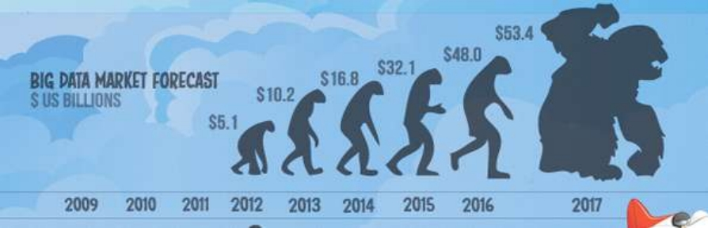
What is BIG DATA
• Walmart handles more than 1 million customer
transactions every hour.
• Facebook handles 40 billion photos from its user base.
• Decoding the human genome originally took 10years to
process; now it can be achieved in one week.

Slide 6
Three Characteristics of Big Data V3s
Volume
• Data
quantity
Velocity
• Data
Speed
Variety
• Data
Types

Slide 7
1 st Character of Big Data
Volume
• A typical PC might have had 10 gigabytes of storage in 2000.
• Today, Facebook ingests 500 terabytes of new data every day.
• Boeing 737 will generate 240 terabytes of flight data during a single
Flight across the US
• The smart phones, the data they create and consume; sensors
embedded into everyday objects will soon result in billions of new,
constantly-updated data feeds containing environmental, location, and other information, including video.
.

Slide 8
2nd Character of Big Data
Velocity
• Clickstreams and ad impressions capture user behavior at
millions of events per second
• high-frequency stock trading algorithms reflect market
changes within microseconds
• machine to machine processes exchange data between
billions of devices
• infrastructure and sensors generate massive log data in real-time
• on-line gaming systems support millions of concurrent users, each producing multiple inputs per second.

Slide 9
3rd Character of Big Data
Variety
• Big Data isn't just numbers, dates, and strings. Big
Data is also geospatial data, 3D data, audio and
video, and unstructured text, including log files and
social media.
•
Traditional database systems were designed to address smaller volumes of structured data, fewer updates or a predictable, consistent data structure.
• Big Data analysis includes different types of data

Slide 10
Storing Big Data
❖ Analyzing your data characteristics
• Selecting data sources for analysis
• Eliminating redundant data
• Establishing the role of NoSQL
❖ Overview of Big Data stores
• Data models: key value, graph, document,
column-family
• Hadoop Distributed File System
• HBase
• Hive

Slide 11
Selecting Big Data stores
• Choosing the correct data stores based on
your data characteristics
• Moving code to data
• Implementing polyglot data store solutions
• Aligning business goals to the appropriate
data store

Slide 12
Processing Big Data
❖ Integrating disparate data stores
• Mapping data to the programming framework
• Connecting and extracting data from storage
• Transforming data for processing
• Subdividing data in preparation for Hadoop
MapReduce
❖ Employing Hadoop MapReduce
• Creating the components of Hadoop MapReduce jobs
• Distributing data processing across server farms
• Executing Hadoop MapReduce jobs
• Monitoring the progress of job flows

Slide 13
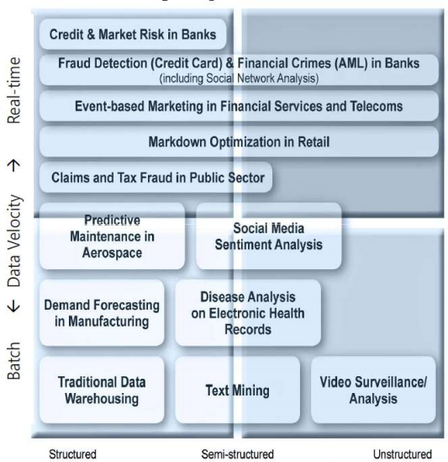
The Structure of Big Data
❖ Structured
• Most traditional data
sources
❖ Semi-structured
• Many sources of big
data
❖ Unstructured
• Video data, audio data
13

Slide 14
Why Big Data
• Growth of Big Data is needed
– Increase of storage capacities
– Increase of processing power
– Availability of data(different data types)
– Every day we create 2.5 quintillion bytes of data;
90% of the data in the world today has been created
in the last two years alone

Slide 15
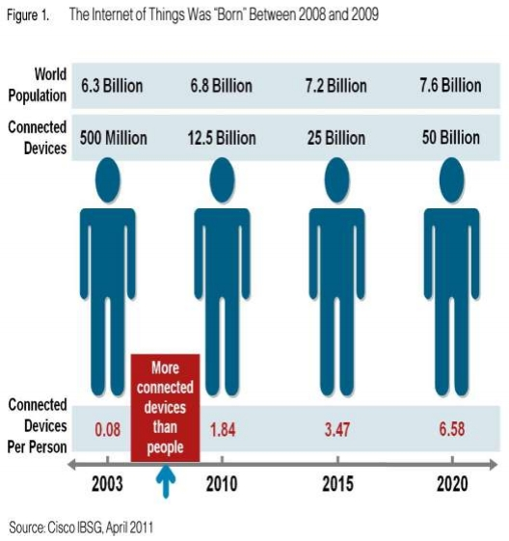
Why Big Data
• FB generates 10TB daily
• Twitter generates 7TB of data
Daily
• IBM claims 90% of today ’s
stored data was generated
in just the last two years.

Slide 16

How Is Big Data Different?
1) Automatically generated by a machine
(e.g. Sensor embedded in an engine)
2) Typically an entirely new source of data
(e.g. Use of the internet)
3) Not designed to be friendly
(e.g. Text streams)
4) May not have much values
• Need to focus on the important part
16

Slide 17
Big Data sources
Users
Application
Systems
Sensors
Large and growing files
(Big data files)

Slide 18
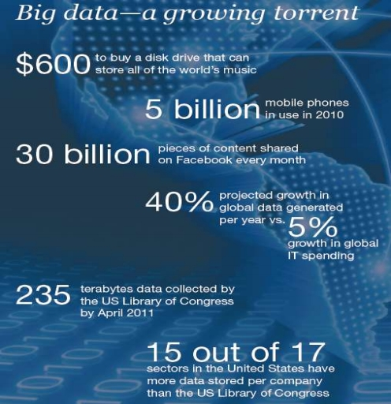
Data generation points Examples
Mobile Devices
Microphones
Readers/Scanners
Science facilities
Programs/ Software
Social Media
Cameras

Slide 19
Big Data Analytics
• Examining large amount of data
• Appropriate information
• Identification of hidden patterns, unknown correlations
• Competitive advantage
• Better business decisions: strategic and operational
• Effective marketing, customer satisfaction, increased revenue

Slide 20
Types of tools used in
Big-Data
• Where processing is hosted ?
– Distributed Servers / Cloud (e.g. Amazon EC2)
• Where data is stored ?
– Distributed Storage (e.g. Amazon S3)
• What is the programming model ?
– Distributed Processing (e.g. MapReduce)
• How data is stored & indexed ?
– High-performance schema-free databases (e.g. MongoDB)
• What operations are performed on data?
– Analytic / Semantic Processing

Slide 21
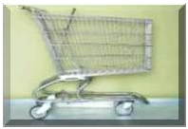

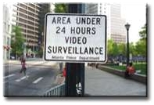


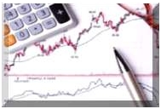


A Application Of Big Data analytics
Smarter
Healthcare
Homeland
Security
Traffic Control
Manufacturing
Multi-channel
sales
Telecom
Trading
Analytics
Search
Quality

Slide 22
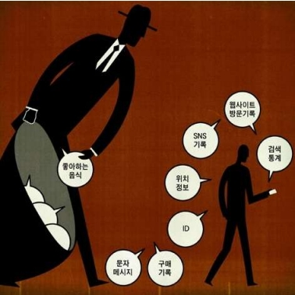
Risks of Big Data
• Will be so overwhelmed
• Need the right people and solve the right problems
• Costs escalate too fast
• Isn’t necessary to capture 100%
• Many sources of big data
is privacy
• self-regulation
• Legal regulation
22

Slide 23
Leading Technology Vendors
Example Vendors
• IBM – Netezza
• EMC – Greenplum
• Oracle – Exadata
Commonality
• MPP architectures
• Commodity Hardware
• RDBMS based
• Full SQL compliance

Slide 24
How Big data impacts on IT
• Big data is a troublesome force presenting
opportunities with challenges to IT organizations.
• By 2015 4.4 million IT jobs in Big Data ; 1.9 million
is in US itself
• India will require a minimum of 1 lakh data
scientists in the next couple of years in addition
to data analysts and data managers to support
the Big Data space.

Slide 25
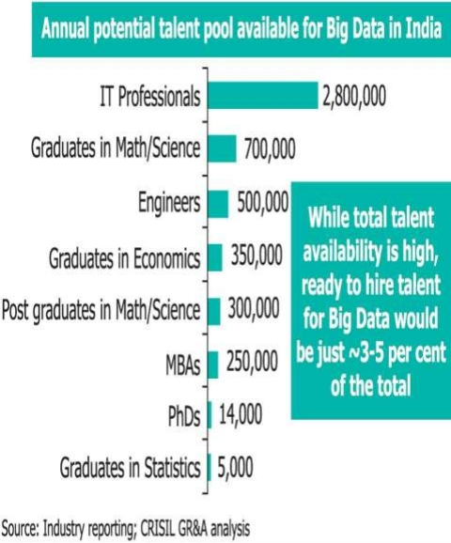
Potential Value of Big Data
• $300 billion potential annual
value to US health care.
• $600 billion potential annual
consumer surplus from using
personal location data.
• 60 % potential in retailers’
operating margins.

Slide 26
India – Big Data
• Gaining attraction
• Huge market opportunities for IT services
(82.9% of revenues) and analytics firms
(17.1 % )
• Current market size is $200 million. By 2015 $1
billion
• The opportunity for Indian service providers lies
in offering services around Big Data
implementation and analytics for global
multinationals

Slide 27
Benefits of Big Data
• Real- time big data isn’t just a process for storing
petabytes or exabytes of data in a data warehouse, It ’s
about the ability to make better decisions and take
meaningful actions at the right time.
• Fast forward to the present and technologies like Hadoop
give you the scale and flexibility to store data before you
know how you are going to process it.
• Technologies such as MapReduce,Hive and Impala enable
you to run queries without changing the data structures
underneath.

Slide 28
Benefits of Big Data
• Our newest research finds that organizations are using big
data to target customer-centric outcomes, tap into internal
data and build a better information ecosystem.
• Big Data is already an important part of the $64 billion
database and data analytics market
• It offers commercial opportunities of a comparable
scale to enterprise software in the late 1980s
• And the Internet boom of the 1990s, and the social media
explosion of today.

Slide 29
Future of Big Data
• $15 billion on software firms only specializing in
data management and analytics.
• This industry on its own is worth more than $100
billion and growing at almost 10% a year which is
roughly twice as fast as the software business as a
whole.
• In February 2012, the open source analyst firm
Wikibon released the first market forecast for Big
Data , listing $5.1B revenue in 2012 with growth to
$53.4B in 2017
• The McKinsey Global Institute estimates that data
volume is growing 40% per year, and will grow 44x
between 2009 and 2020.

Slide 30
References
• www.Slideshare.com
• www.wikipedia.com
• www.computereducation.org
• Books-
➢ Big Data by Viktor Mayer-Schonberger

Slide 31
Thank You.

